Slide 1

Stretnutie 8:
Internet Protocol v. 6
ROUTE Module 8

Slide 2
Prečo IPv6?
Rôzne dôvody
  Protokol IPv4 je už 30 rokov starý
    Niektoré jeho vlastnosti sa časom ukázali ako nevyužívané (možno dokonca nebezpečné)
    Iné vlastnosti potrebné pre súčasné siete mu zasa chýbajú
    Za 30 rokov sa veľa zmení a dá sa veľa dobrým veciam naučiť, prípadne odpozerať ☺
  Najväčším strašiakom je už dlhší čas malý adresový priestor IPv4 – cca 4 mld. adries

Slide 3
Ciele návrhu IPv6
Väčší adresový priestor s rozumnou rezervou
Návrat k end-to-end dosiahnuteľnosti
Lepšie predpoklady pre hierarchické smerovanie
Zväčšenie kompetencií protokolu ICMP
Zvýšenie bezpečnosti
Optimalizácia pre vysokorýchlostné smerovanie
Automatická konfigurácia (Plug-and-Play)
Podpora mobility
Hladký prechod z IPv4 na IPv6

Slide 4
Vlastnosti IPv6
Väčší adresový priestor
Globálna dosiahnuteľnosť
Agregácia
Multihoming
Autokonfigurácia
Komunikácia bez NAT
Jednoduchšia hlavička
Efektívne smerovanie
Bez broadcastov
Bez kontrolných súm
Rozširujúce hlavičky
Flow labels (návestia tokov)
Notes:
IPv6 is a powerful enhancement to IPv4. There are several features in IPv6 that offer functional improvements. What IP developers learned from using IPv4 suggested changes to better suit current and foreseeable network demands:
Larger address space: Larger address space includes several enhancements: improved global reachability and flexibility; the aggregation of prefixes that are announced in routing tables; multihoming to several Internet service providers (ISPs); autoconfiguration that can include link-layer addresses in the address space; plug-and-play options; and public-to private readdressing end to end without address translation; and simplified mechanisms for address renumbering and modification.
Simpler header: A simpler header offers several advantages over IPv4: better routing efficiency for performance and forwarding-rate scalability; no broadcasts and thus no potential threat of broadcast storms; no requirement for processing checksums; simpler and more efficient extension header mechanisms; and flow labels for per-flow processing with no need to open the transport inner packet to identify the various traffic flows.

Slide 5
Vlastnosti IPv6
Mobilita a bezpečnosť
Mobilita pokrytá RFC dokumentom
Povinná podpora IPSec
Migrácia
Dual stack
Tunelovanie
Preklad
Notes:
Mobility and security: Mobility and security help ensure compliance with mobile IP and IPSec standards functionality. Mobility enables people to move around in networks with mobile network devices—with many having wireless connectivity.
Mobile IP is an Internet Engineering Task Force (IETF) standard available for both IPv4 and IPv6. The standard enables mobile devices to move without breaks in established network connections. Because IPv4 does not automatically provide this kind of mobility, you must add it with additional configurations.
In IPv6, mobility is built in, which means that any IPv6 node can use it when necessary. The routing headers of IPv6 make mobile IPv6 much more efficient for end nodes than mobile IPv4.
IPSec is the IETF standard for IP network security, available for both IPv4 and IPv6. Although the functionalities are essentially identical in both environments, IPSec is mandatory in IPv6. IPSec is enabled on every IPv6 node and is available for use. The availability of IPSec on all nodes makes the IPv6 Internet more secure. IPSec also requires keys for each party, which implies a global key deployment and distribution.
Transition richness: There are multiple ways to incorporate existing IPv4 capabilities with the added features of IPv6:
One approach is to have a dual stack with both IPv4 and IPv6 configured on the interface of a network device.
Another technique—called “IPv6 over IPv4” or “6to4” tunneling—uses an IPv4 tunnel to carry IPv6 traffic. This newer method (RFC 3056) replaces an older technique of IPv4-compatible tunneling (RFC 2893). Cisco IOS Software Release 12.3(2)T (and later) also allows protocol translation (NAT-PT) between IPv6 and IPv4. This translation allows direct communication between hosts speaking different protocols.

Slide 6

Formát IPv6 paketov

Slide 7
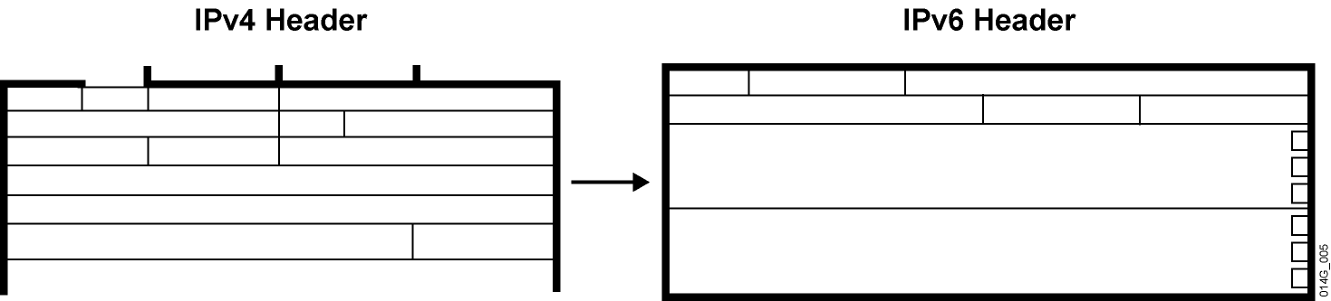
Jednoduchšia a efektívnejšia hlavička
Polia spravidla zarovnané na hranice 64 bitov
Menší počet polí
Možnosť pre jednoduchšiu a výkonnejšiu implementáciu HW
Notes:
The IP version 4 (IPv4) header contains 12 basic header fields, followed by an options field and a data portion (usually the transport layer segment). The basic IPv4 header has a fixed size of 20 octets. The variable-length options field increases the size of the total IP header. IPv6 contains 5 of the 12 IPv4 basic header fields. The IPv6 header does not require the other seven fields.

Slide 8
Porovnanie hlavičiek IPv4 a IPv6
IPv4 Header
IPv6 Header
Version
IHL
Type of
Service
Total Length
Version
Traffic
Class
Flow Label
Identification
Flags
Fragment
Offset
Payload Length
Next
Header
Hop Limit
Time to Live
Protocol
Header Checksum
Source Address
Source Address
Destination Address
Options
Padding
Polia rovnakého významu
Polia vypustené z IPv6 hlavičky
Polia so zmeneným názvom a polohou
Nové polia v IPv6 hlavičke
Destination Address
Legenda
Notes:
Streamlined
Fragmentation fields moved out of base header
IP options moved out of base header
Header Checksum eliminated
Header Length field eliminated
Length field excludes IPv6 header
Alignment changed from 32 to 64 bits
Revised
Time to Live → Hop Limit
Protocol → Next Header
Precedence and TOS → Traffic Class
Addresses increased 32 bits → 128 bits
Extended
Flow Label field added
The IPv6 header has 40 octets in contrast to the 20 octets in IPv4. IPv6 has a smaller number of fields, and the header is 64-bit aligned to enable fast processing by current processors. Address fields are four times larger than in IPv4.
The IPv6 header contains these fields:
Version: A 4-bit field, the same as in IPv4. It contains the number 6 instead of the number 4 for IPv4.
Traffic Class: An 8-bit field similar to the type of service (ToS) field in IPv4. It tags the packet with a traffic class that it uses in differentiated services (DiffServ). These functionalities are the same for IPv6 and IPv4.
Flow Label: A completely new 20-bit field. It tags a flow for the IP packets. It can be used for multilayer switching techniques and faster packet-switching performance.
Payload Length: Similar to the Total Length field of IPv4.
Next Header: The value of this field determines the type of information that follows the basic IPv6 header. It can be a transport-layer packet, such as TCP or UDP, or it can be an extension header. The next header field is similar to the Protocol field of IPv4.
Hop Limit: This field specifies the maximum number of hops that an IP packet can traverse. Each hop or router decreases this field by one (similar to the Time to Live [TTL] field in IPv4). Because there is no checksum in the IPv6 header, the router can decrease the field without recomputing the checksum. On IPv4 routers the recomputation costs processing time.
Source Address: This field has 16 octets or 128 bits. It identifies the source of the packet.
Destination Address: This field has 16 octets or 128 bits. It identifies the destination of the packet.
Extension Headers: The extension headers, if any, and the data portion of the packet follow the eight fields. The number of extension headers is not fixed, so the total length of the extension header chain is variable.

Slide 9
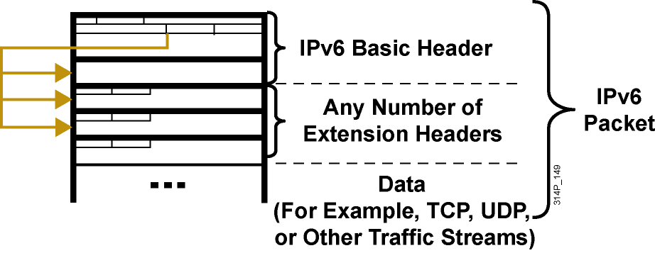
Rozširujúce hlavičky v IPv6
IPv6 má pre množstvo funkcií rozširujúce hlavičky
IPv6 efektívnejšie implementuje voliteľné časti hlavičky
Notes:
There are many types of extension headers. When multiple extension headers are used in the same packet, the order of the headers should be as follows:
IPv6 header: This header is the basic header described in the previous figure.
Hop-by-hop options header: When this header is used for the router alert (Resource Reservation Protocol [RSVP] and Multicast Listener Discovery version 1 [MLDv1]) and the jumbogram, this header (value = 0) is processed by all hops in the path of a packet. When present, the hop-by-hop options header always follows immediately after the basic IPv6 packet header.
Destination options header (when the routing header is used): This header (value = 60) can follow any hop-by-hop options header, in which case the destination options header is processed at the final destination and also at each visited address specified by a routing header. Alternatively, the destination options header can follow any Encapsulating Security Payload (ESP) header, in which case the destination options header is processed only at the final destination. For example, mobile IP uses this header.
Routing header: This header (value = 43) is used for source routing and mobile IPv6.
Fragment header: This header is used when a source must fragment a packet that is larger than the MTU for the path between itself and a destination device. The fragment header is used in each fragmented packet.
Authentication header and Encapsulating Security Payload header: The authentication header (value = 51) and the ESP header (value = 50) are used within IPsec to provide authentication, integrity, and confidentiality of a packet. These headers are identical for both IPv4 and IPv6.
Upper-layer header: The upper-layer (transport) headers are the typical headers used inside a packet to transport the data. The two main transport protocols are TCP (value = 6) and UDP (value = 17).

Slide 10
Záležitosti týkajúce sa MTU
Pre IPv6 je stanovené minimálne MTU na 1280B (staršie IPv4 malo minimálne MTU 68B)
  Na rozhraniach, kde je MTU < 1280B, sa musí použiť špecifický mechanizmus linkového protokolu pre fragmentáciu a opätovné poskladanie
  IPv6 routery na rozdiel od IPv4 už nerealizujú fragmentáciu paketu
  Pokiaľ je to nevyhnutné, fragmentáciu vykonáva priamo odosielateľ
Od implementácií IPv6 sa očakáva, že sú schopné realizovať tzv. path MTU discovery, ak chcú posielať pakety väčšie než 1280B
Minimalistické implementácie IPv6 môžu path MTU discovery vynechať, ak všetky pakety udržia na veľkosti ≤ 1280B
IPv6 podporuje pakety veľké až 2³² B (tzv. jumbogramy)
Notes:
Routers handle fragmentation in IPv4, which causes a variety of processing issues. IPv6 routers no longer perform fragmentation. Instead, a discovery process is used to determine the optimum maximum transmission unit (MTU) to use during a given session.
In the discovery process, the source IPv6 device attempts to send a packet at the size that is specified by the upper IP layers, for example, the transport and application layers.
If the device receives an “ICMP packet too big” message, it retransmits the MTU discover packet with a smaller MTU and repeats the process until it gets a response that the discover packet arrived intact. Then it sets the MTU for the session.
The “ICMP packet too big” message contains the proper MTU size for the pathway. Each source device needs to track the MTU size for each session. Generally, the tracking is done by creating a cache that is based on the destination address; however, it can also be done by using the flow label. If source-based routing is performed, the tracking of the MTU size can be done by using the source address.
The discovery process is beneficial because, as routing pathways change, a new MTU might be more appropriate. When a device receives an “ICMP packet too big” message, it decreases its MTU size if the Internet Control Message Protocol (ICMP) message contains a recommended MTU that is less than the current MTU of the device.
A device performs an MTU discovery every 5 minutes to see whether the MTU has increased along the pathway. Application and transport layers for IPv6 accept MTU reduction notifications from the IPv6 layer.
If they do not accept the notifications, IPv6 has a mechanism to fragment packets that are too large; however, upper layers are encouraged to avoid sending messages that require fragmentation.
Link-layer technologies already perform checksum and error control. Because link-layer technologies are relatively reliable, an IP header checksum is considered to be redundant. Without the IP header checksum, the upper-layer optional checksums, such as User Datagram Protocol (UDP), are now mandatory.

Slide 11
Adresovanie v IPv6

Slide 12
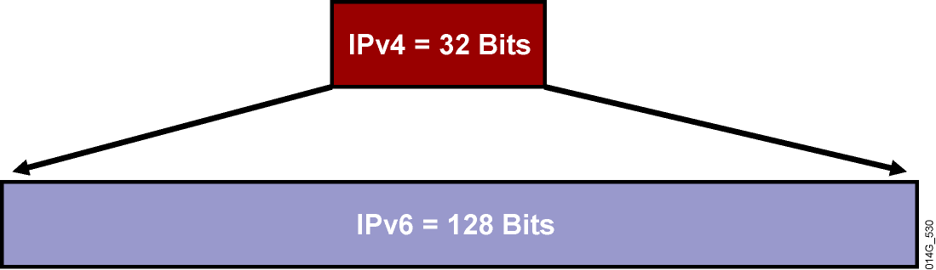
Väčší adresový priestor
IPv4
32 bitov
    ~ 4,200,000,000 adresovateľných uzlov
IPv6
128 bitov (16 bajtov): štvornásobná dĺžka oproti IPv4
    ~ 3.4 * 10³⁸ adresovateľných uzlov
    ~ 340,282,366,920,938,463,374,607,432,768,211,456
    ~ 5 * 10²⁸ adries na osobu
Notes:
IPv6 increases the number of address bits by a factor of 4, from 32 to 128. This factor enables a very large number of addressable nodes; however, as in any addressing scheme, not all the addresses are used or available.
Current IPv4 protocol address use is extended by applying techniques such as NAT and temporary address allocations. But the manipulation of data payload by intermediate devices challenges (or complicates) the advantages of peer-to-peer communication, end-to-end security, and quality of service (QoS).
IPv6 gives every user multiple global addresses that can be used for a wide variety of devices, including cell phones, personal digital assistants (PDAs), and IP-enabled vehicles. Quadrupling the available 32-bit IPv4 address space to 128 bits, IPv6 addresses the need for always-on environments. These addresses are reachable without using IP address translation, pooling, and temporary allocation techniques.
Increasing the number of bits for the address also increases the IPv6 header size. Because each IP header contains a source and a destination address, the size of the header fields that contains the addresses is 256 bits for IPv6 compared to 64 bits for IPv4.
Note: For more IETF information on IPv6 addressing details, refer to RFC 3513.

Slide 13
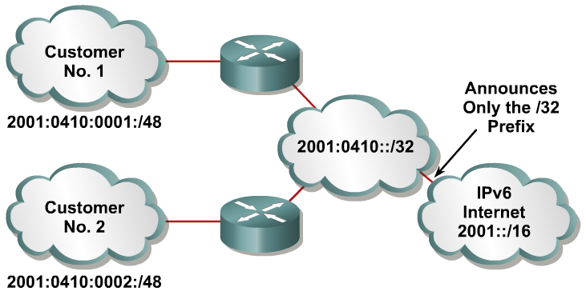
Veľký adresový priestor s efektívnou agregáciou
Do globálnych smerovacích tabuliek sa ohlasujú agregované prefixy
  Do istej miery toto pripomína návrat ku classful smerovaniu, hoci sa to nedá takto v pravom zmysle slova nazvať
Efektívne a škálovateľné smerovanie
Notes:
Larger address spaces make room for large address allocations to ISPs and organizations. An ISP aggregates all the prefixes of its customers into a single prefix and announces the single prefix to the IPv6 Internet. The increased address space is sufficient to allow organizations to define a single prefix for the entire network as well.
Aggregation of customer prefixes results in an efficient and scalable routing table. Scalable routing is necessary to expand broader adoption of network functions. Improved network bandwidth and functionality for user traffic will connect the various devices and applications. Internet usage—both now and in the future—can include these elements:
A huge increase in the number of broadband consumers with high-speed, always-on connections
Users who spend more time online and are generally willing to spend more money on communications services (such as music) and high-value searchable offerings
Home networks with expanded network applications such as wireless Voice over IP (VoIP), home surveillance, and advanced services such as real-time video on demand (VoD)
Massively scalable games with global participants and media-rich e-learning, providing learners with on-demand remote labs or lab simulations

Slide 14
Zápis IPv6 adries
x:x:x:x:x:x:x:x, kde x je 16-bitové hexadecimálne pole
Úvodné nuly v hexadecimálnom poli sú nepovinné
  2031:0:130F:0:0:9C0:876A:130B
Za sebou idúce polia 0 sa dajú skrátiť zápisom ::, avšak len jedenkrát v adrese
Príklady:
  2031:0000:130F:0000:0000:09C0:876A:130B
  2031:0:130f::9c0:876a:130b
  FF01:0:0:0:0:0:0:1 >>> FF01::1
  0:0:0:0:0:0:0:1 >>> ::1
  0:0:0:0:0:0:0:0 >>> ::
Notes:
IPv6 addresses are shown in hexadecimal and there are appropriate methods for abbreviation of addresses. Colons separate entries in a series of 16-bit hexadecimal fields that represent IPv6 addresses. The hexadecimal digits A, B, C, D, E, and F represented in IPv6 are not case-sensitive. IPv6 does not require explicit address string notation.
Use the following guidelines for IPv6 address string notations:
The leading zeros in a field are optional, so that 09C0 = 9C0 and 0000 = 0.
Successive fields of zeros can be represented as “::” only once in an address.
An unspecified address is written as “::” because it contains only zeros.
Using the “::” notation greatly reduces the size of most addresses. For example, FF01:0:0:0:0:0:0:1 becomes FF01::1.
Note: An address parser identifies the number of missing zeros by separating the two parts and entering 0 until the 128 bits are complete. If two “::” notations are placed in the address, there is no way to identify the size of each block of zeros.

Slide 15
Adresový model v IPv6
Adresy sa priradzujú rozhraniam
Rozhranie v IPv6 má spravidla niekoľko adries
  V IPv4 má rozhranie typicky len 1 adresu
Adresy majú svoj rozsah (scope)
  Link Local
  Global
  Site-local (zastaralý)
Adresy majú čas platnosti
  Platnosť a preferovaný čas platnosti
  Týka sa adries získaných bezstavovou autokonfiguráciou
Adresy majú svoj typ
Global
Unique Local
Link Local
Notes:
Now we know how to represent IPv6 in IPv6 format lets look at the IPv6 addressing model

Slide 16
Typy adries
Unicast
  Adresa patrí jednému rozhraniu
  Existuje mnoho podtypov (napr. globálne a IPv4-mapované)
Multicast
  Pre one-to-many adresovanie
  Efektívnejšie využíva prostriedky siete
  Používa širší adresový rozsah
Anycast
  One-to-nearest (alokované z unicastového priestoru)
  Viaceré zariadenia zdieľajú tú istú adresu
  Všetky takéto zariadenia by mali poskytovať rovnaké služby
  Zdrojové zariadenia odosielajú pakety na anycast adresu
  Smerovače rozhodnú o najbližšom uzle s danou adresou
  Vhodné pre load balancing a poskytovanie obsahu (content delivery)
Notes:
Broadcasting in IPv4 results in a number of problems. Broadcasting generates a number of interrupts in every computer on the network and, in some cases, triggers malfunctions that can completely halt an entire network. This disastrous network event is known as a “broadcast storm.”
In IPv6, broadcasting does not exist. Broadcasts are replaced by multicasts and anycasts. Multicast enables efficient network operation by using a number of functionally specific multicast groups to send requests to a limited number of computers on the network. The multicast groups prevent most of the problems that are related to broadcast storms in IPv4.
The range of multicast addresses in IPv6 is larger than in IPv4. For the foreseeable future, allocation of multicast groups is not being limited.
IPv6 also defines a new type of address called an anycast address. An anycast address identifies a list of devices or nodes; therefore, an anycast address identifies multiple interfaces. A packet sent to an anycast address is delivered to the closest interface—as defined by the routing protocols in use—identified by the anycast address.
Anycast addresses are syntactically indistinguishable from global unicast addresses because anycast addresses are allocated from the global unicast address space.
Note: Anycast addresses must not be used as the source address of an IPv6 packet.

Slide 17
Unicastové adresovanie v IPv6
Adresy sa priradzujú rozhraniam
Rozhranie v IPv6 má, až na výnimky, niekoľko adries
  V IPv4 má rozhranie typicky len 1 adresu
Aktuálna IPv6 adresová architektúra je popísaná v RFC 4291
  ::/128 Nešpecifikovaná adresa
  ::1/128 Loopback
  FF00::/8 Multicast
  FE80::/10 Link-Local Unicast
  FEC0::/10 Site local Unicast, zrušené v RFC 3879
  FC00::/7 Unique Local Unicast, RFC 4193
  ::A.B.C.D IPv4-kompatibilné adresy (neodporúčané)
  ::FFFF:A.B.C.D IPv4-mapované adresy
  Všetko ostatné Global Unicast
Notes:
The IPv6 unicast address space encompasses the entire IPv6 address range, with the exception of FF00::/8 (1111 1111), which is used for multicast addresses. The current global unicast address assignment by the Internet Assigned Numbers Authority (IANA) uses the range of addresses that start with binary value 001 (2000::/3), which is one-eighth of the total IPv6 address space and is the largest block of assigned block addresses.
Addresses with a prefix of 2000::/3 (001) through E000::/3 (111), with the exception of the FF00::/8 (1111 1111) multicast addresses, are required to have 64-bit interface identifiers in the extended universal identifier (EUI)-64 format.
The IANA is allocating the IPv6 address space in the ranges of 2001::/16 to the registries.
The global unicast address typically consists of a 48-bit global routing prefix and a 16-bit subnet ID. In the now obsolete RFC 2374, An IPv6 Aggregatable Global Unicast Address Format, the global routing prefix included two other hierarchically structured fields called Top‑Level Aggregator and Next-Level Aggregator. Because these fields were policy-based, the Internet Engineering Task Force (IETF) decided to remove them from the RFCs. However, some existing IPv6 networks deployed in the early days might still be using networks based on the older architecture. A 16-bit subnet field called Subnet ID could be used by individual organizations to create their own local addressing hierarchy and to identify subnets. This field allows an organization to use up to 65,535 individual subnets. (RFC 2374 has now been replaced by RFC 3587, IPv6 Aggregatable Global Unicast Address Format.)

Slide 18
IPv6 adresy na rozhraniach
Adresy typu Global Unicast a Anycast majú rovnaký formát
  Obsahujú tzv. globálny smerovací prefix, pomocou ktorého sa dá významne agregovať adresa až po providera
Na rozhraní môže byť ľubovoľný počet adries každého typu
  Každé IPv6 rozhranie musí mať priradenú prinajmenšom link-local adresu
  Každé IPv6 rozhranie môže mať priradené viaceré unikátne lokálne či globálne adresy
  Z tohto pohľadu je anycastová adresa jednoducho adresa, ktorá je spoločne pridelená viacerým rozhraniam (spravidla na rôznych zariadeniach)
Notes:
The global unicast and the anycast share the same address format. The unicast address space allocates the anycast addresses. To devices that are not configured for anycast, these addresses appear as unicast addresses.
When a unicast address is assigned to more than one interface, thus turning it into an anycast address, the nodes to which the address is assigned must be explicitly configured to use and recognize the anycast address.
A packet that is sent to an anycast address routes to the closest device or interface that shares this address. A sender creates a packet with the anycast as the destination address and forwards it to its nearest router. The source can use the anycast addresses to control the pathway across which traffic flows.
Examples: Multiple ISPs and LANs with Multiple Routers
An example of anycast use in a Border Gateway Protocol (BGP) multihomed network is when a customer has multiple ISPs with multiple connections to one another. The customer can configure a different anycast address for each ISP.
Each router for the given ISP has the same configured anycast address. The source device can choose which ISP to send the packet to; however, the routers along the path determine the closest router to reach that ISP using the IPv6 anycast address.
Another use for an anycast is when a LAN is attached to multiple routers. These routers can have the same IPv6 anycast address so that distant devices need to identify only the anycast address. Intermediate devices can choose the best pathway to reach the closest entry point to that subnet.

Slide 19
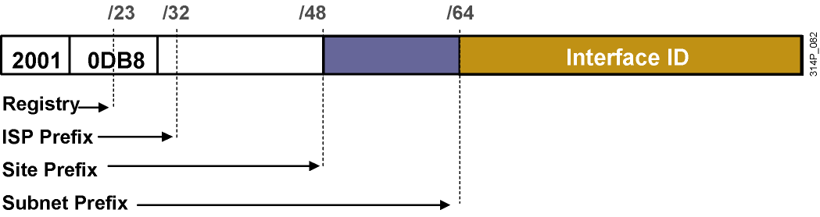
IPv6 adresy Global Unicast a Anycast
Adresa typu Global Unicast a Anycast má tri časti
  Global Routing Prefix
  Subnet ID
  Interface ID
Štruktúra GRP a SID nie je fixná
  Požaduje sa, aby Interface ID malo 64 bitov, ak IPv6 adresa začína bitmi inými než 000/3
  V súčasnosti sa prideľujú Global Unicast adresy s prefixom /48
    Subnet ID má teda 16 bitov
Notes:
The IPv6 global unicast address is the equivalent of the IPv4 global unicast address. A global unicast address is an IPv6 address from the global unicast prefix. The structure of global unicast addresses enables aggregation of routing prefixes that limits the number of routing table entries in the global routing table. Global unicast addresses used on links are aggregated upward through organizations and eventually to the Internet service providers (ISPs).
Global unicast addresses are defined by a global routing prefix, a subnet ID, and an interface ID.

Slide 20
IPv6 adresy Global Unicast
Provider
Site
Host
3
45 Bits
16 Bits
64 Bits
Global Routing Prefix
Subnet
Interface ID
001
Štruktúrované hierarchicky, aby umožnili agregáciu
Tento formát adries sa používa pre unikátne a verejne viditeľné adresy IPv6 staníc
Notes:
The Aggregatable Global Unicast Addresses correspond to the principal use of IPv6 addresses for the generic IPv6 traffic and consume the most important part of the address space. The structure enables strict aggregation of routing prefixes in order to limit the number of routing table entries in the global routing table.

Slide 21
IPv6 adresy Global Unicast
IPv6 Interface ID
Pre bezstavovú konfiguráciu IPv6 adresy sa na Cisco smerovačoch využíva tzv. modified extended universal identifier – modified EUI-64
  Modified EUI-64 má 64 bitov a vkladá sa do časti Interface ID
Modified EUI-64 sa získa z MAC adresy tým, že:
  Medzi OUI a S/N sa vloží dvojbajt FF:FE
  Invertuje sa bit U/L (druhý najnižší bit 1. bajtu MAC)
Notes:
Use of EUI-64 Format in IPv6 Addresses
The 64-bit interface identifier is an IPv6 address is used to identify a unique interface on a link. A link is a network medium over which network nodes communicate using the link layer. The interface identifier may also be unique over a broader scope. In many cases, an interface identifier will be the same as or is based on the link-layer (MAC) address of an interface. As in IPv4, a subnet prefix in IPv6 is associated with one link.
Interface identifiers used in global unicast and other IPv6 address types must be 64 bits long and constructed in the Extended Universal Identifier (EUI)-64 format. The EUI-64 format interface ID is derived from the 48-bit link-layer (MAC) address by inserting the hexadecimal number FFFE between the upper 3 bytes (Organizational Unique Identifier [OUI] field) and the lower 3 bytes (serial number) of the link layer address. To make sure that the chosen address is from a unique Ethernet MAC address, the seventh bit in the high-order byte is set to 1 (equivalent to the IEEE G/L bit) to indicate the uniqueness of the 48-bit address.

Slide 22

Konverzia MAC adresy na EUI-64
Notes:
MAC Address to Modified EUI-64 to IPv6 Interface Identifier
The IPv6 interface identifier for stateless auto-configuration in an Ethernet environment uses the modified EUI-64 format. The transformation begins by taking the MAC address of the interface.
This format expands the 48-bit Ethernet MAC address format to a 64-bit version by inserting "FFFE" in the middle of the 48 bits.
This creates a 64-bit, unique interface identifier.
The 7th bit (starting with the leftmost bit as “1”) in an IPv6 interface identifier is referred to as the Universal/Local bit, or U/L bit.
This bit identifies whether this interface identifier is locally unique on the link or that it is universally unique.
To make sure that the chosen address is from a unique Ethernet MAC address, the universal/local (“u” bit) is set to 1 for global scope and 0 for local scope.
In the case where the interface identifier is created from an Ethernet MAC address, it is assumed that the MAC address is universally unique and, therefore, the interface identifier is universally unique.
The rationale of the U/L bit is for future use of the upper-layer protocols to uniquely identify a connection, even in the context of a change in the leftmost part of the address. However, this is not yet used.
The 8th bit (starting with leftmost bit as “1”), also known as the “G” bit, is a group/individual bit for managing groups. The unicast/group (“g” bit) is set to 1 for group and 0 for unicast.
Because of certain privacy and security concerns, the implementation of autoconfiguration by a host may also create a random interface identifier using the MAC address as a base. This is considered a privacy extension because, without it, creating an interface identifier from a MAC address provides the ability to track the activity and point of connection.
Microsoft Windows XP is currently the only known implementation of this capability and prefers to use this address for outgoing communication, because the address has a short lifetime and will be regenerated periodically.
Note: This process is defined in RFC 3041.

Slide 23
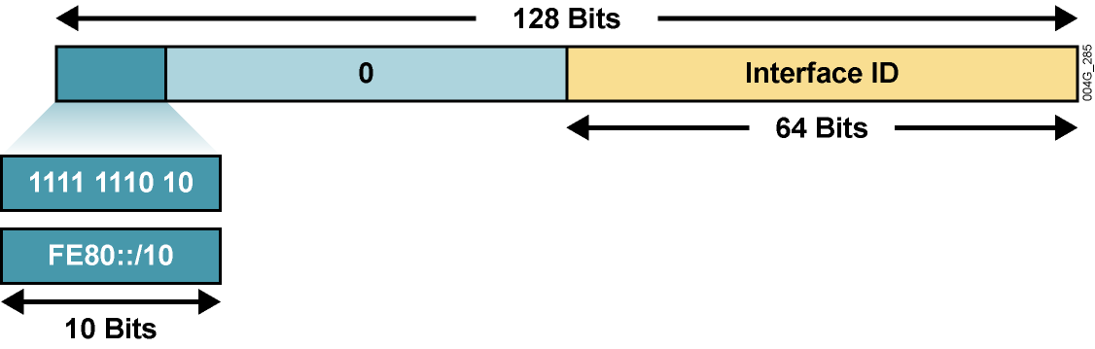
IPv6 adresy typu Link-Local Unicast
Remaining 54 bits
Link-local adresa pozostáva z prefixu FE80::/10, ľubovoľných 54 bitov a Interface ID vo formáte EUI-64
Adresy povinné pre komunikáciu dvoch susedných zariadení
Automaticky vytvorené routerom na rozhraniach hneď, ako je aktivovaná podpora IPv6
Takisto sa využívajú v smerovacích protokoloch ako next-hop adresy
Sú jedinečné a platné len v rámci broadcastovej domény
54 bitov medzi prefixom a Interface ID môže byť ľubovoľných
Notes:
Link-local addresses have a scope limited to the link and are dynamically created on all IPv6 interfaces by using a specific link-local prefix FE80::/10 and a 64-bit interface identifier.
Interface identifiers in IPv6 addresses are used to identify interfaces on a link. They may also be thought of as the “host portion” of an IPv6 address. Interface identifiers are required to be unique on that link.
Interface identifiers are always 64 bits and are dynamically created based on Layer 2 media and encapsulation.
Link-local addresses are used for automatic address configuration, neighbor discovery, and router discovery. Link-local addresses are also used by many routing protocols.
Link-local addresses can serve as a way to connect devices on the same local network without needing global addresses.
Interface identifiers may also be unique over a broader scope: When the interface identifier is derived directly from the data link layer address of the interface (for example, IEEE 802.1Q MAC), the scope of that identifier is assumed to be universal (global).
When communicating with a link-local address, you must specify the outgoing interface because every interface is connected to FE80::/10.
IPv6 over Data Link Layers
IPv6 is defined on most of the current data link layers, including the following:
Ethernet*
PPP*
High-Level Data Link Control (HDLC)*
FDDI
Token Ring
Attached Resource Computer Network (ARCNET)
Nonbroadcast multiaccess (NBMA)
ATM**
Frame Relay***
IEEE 1394
* Cisco supports these data link layers.
** Cisco supports only ATM permanent virtual circuit (PVC) and ATM LAN Emulation (LANE).
*** Cisco supports only Frame Relay PVC.
An RFC describes the behavior of IPv6 in each of these specific data link layers, but Cisco IOS software does not necessarily support all of them. The data link layer defines how IPv6 interface identifiers are created and how neighbor discovery deals with data link layer address resolution.

Slide 24
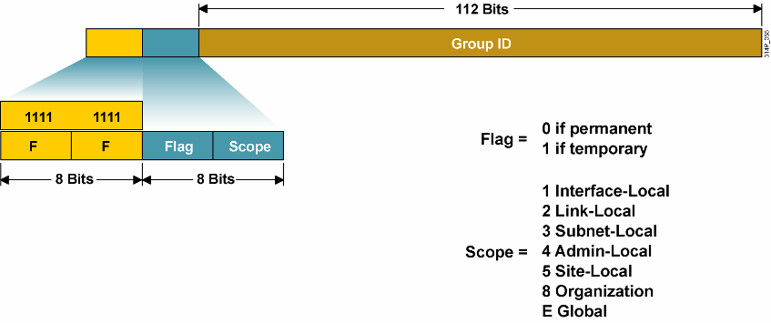
IPv6 multicastové adresy
Multicasty sa v IPv6 využívajú veľmi často
Broadcast sa v IPv6 nepoužíva
Notes:
A multicast address identifies a group of interfaces. Traffic sent to a multicast address travels to multiple destinations at the same time. An interface may belong to any number of multicast groups. Multicasting is extremely important to IPv6, because it is at the core of many IPv6 functions.
IPv6 multicast addresses are defined by the prefix FF00::/8. The second octet defines the lifetime (flag) and the scope of the multicast address.
The flag parameter is equal to 0 for a permanent, or well-known, multicast address. For a temporary multicast address, the flag is equal to 1.
The scope parameter is equal to 1 for the scope of the interface (loopback transmission), 2 for the link scope (similar to unicast link-local scope), 3 for subnet-local scope where subnets may span multiple links, 4 for admin-local scope (administratively configured), 5 for the site scope, 8 for the organizational scope (multiple sites), and E for the global scope. For example, a multicast address starting with FF02::/16 is a permanent multicast address with a link-local scope.
The multicast group ID consists of the lower 112 bits of the multicast address.
Multicast is frequently used in IPv6 and replaces broadcast. There is no broadcast in IPv6.
There is no Time to Live (TTL) in IPv6 multicast. The scoping is defined inside the address.

Slide 25
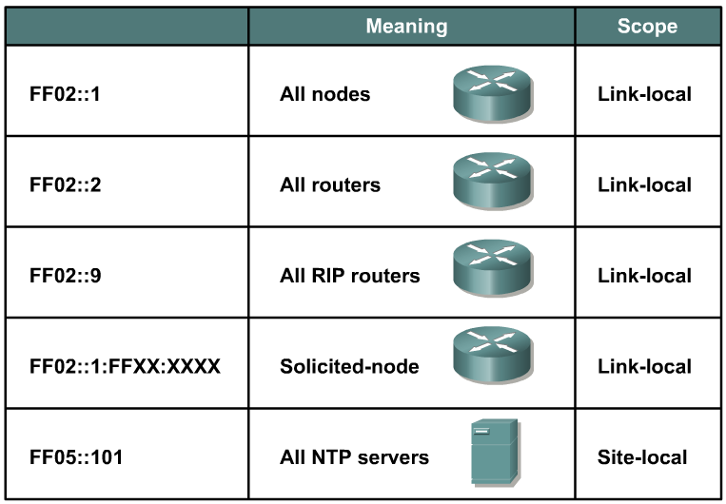
Príklady pevných multicastových IPv6 adries
Notes:
The multicast addresses, FF00:: to FF0F::, are reserved. Within that range, the following are some examples of assigned addresses (there are many more assignments made; assignments are tracked by the Internet Assigned Numbers Authority [IANA]):
FF02::1 — All nodes on link (link-local scope)
FF02::2 — All routers on link
FF02::5 — All OSPF routers on link
FF02::6 — All DR routers on link
FF02::9 — All Routing Information Protocol (RIP) routers on link
FF02::1:FFXX:XXXX — Solicited-node multicast on link, where XX:XXXX is the rightmost 24 bits of the corresponding unicast or anycast address of the node. (Neighbor solicitation messages are sent on a local link when a node wants to determine the link-layer address of another node on the same local link, similar to Address Resolution Protocol [ARP] in IPv4.)
FF05::101 — All Network Time Protocol (NTP) servers in the site (site-local scope)
The site-local multicast scope has an administratively assigned radius and has no direct correlation to the (now deprecated) site-local unicast prefix of FEC0::/10.

Slide 26
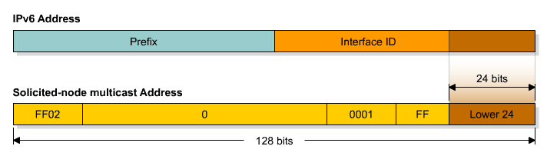
Multicastové adresy Solicited-Node
Solicited-node multicast adresa pozostáva z prefixu FF02::1:FF:/104 a spodných 24 bitov IPv6 adresy hľadaného suseda
  Typické použitie je v ICMPv6, ktoré nahrádza ARP
  ICMPv6 je vo vnútri IPv6 paketu, takže paket musí mať adresu príjemcu, v tomto prípade práve Solicited-Node
Adresa má rozsah link-local
Notes:
Solicited-node Address
Solicited-node addresses are multicast addresses used in neighbor solicitation messages to help with neighbor discovery. An IPV6 node must join the multicast group corresponding to each of its unicast and anycast addresses. The solicited-node address is composed of the following: FF02:0:0:0:0:1:FF/104 prefix concatenated by the rightmost 24 bits of the corresponding unicast or anycast address of the node. As a FF02::/16 address, a solicited-node multicast address has the scope of link-local.
In very rare cases, the rightmost 24 bits of the unicast address of the target will not be unique on the link. Solicited–node multicast addresses are used in IPv6 for address resolution of an IPv6 address to a MAC address on a LAN segment. For example, consider two nodes with addresses 2001:DB8:200:300:400:500:aaaa:bbbb and 2001:DB8:200:300:400:501:aaaa:bbbb, where the link prefix is 2001:DB8:200:300::/64. These two nodes, then, would be listening to the same solicited-node multicast address. Each would receive the multicast packet, but only the node whose full address matched the full target address of the multicast packet (embedded in the data field of the multicast packet) would respond with a neighbor advertisement (which includes the actual MAC address). The other node would receive the multicast packet, but upon inspection of the embedded target address would realize that it was not the intended recipient of the request, and would not respond.
The following example describes how this situation would work.
Node A has this characteristic:
Address 2001:DB8:200:300:400:500:1234:5678
Node B has these characteristics:
Address 2001:DB8:200:300:500:AAAA:BBBB
Solicited-node multicast address FF02:0:0:0:0:1:FFAA:BBBB (the same as node C)
Node C has these characteristics:
Address 2001:DB8:200:300:501:AAAA:BBBB
Solicited-node multicast address FF02:0:0:0:0:1:FFAA:BBBB (the same as node B)
Node A desires to exchange packets with node B. Node A sends a neighbor discovery packet to the solicited-node multicast address of B, FF02:0:0:0:0:1:AAAA:BBBB, as described previously. Inside the packet, in addition to other data, is the full IPv6 address that node A is looking for—2001:DB8:200:300:500:AAAA:BBBB. This is called the target address.
Both node B and node C are listening to the same multicast address, so they both receive and process the packet.
Node B sees that the target address inside the packet is its own and responds as described previously.
Node C sees that the target address inside the packet is not its own and does not respond
at all.
In this manner, nodes can have the same solicited-node multicast address on the link without causing neighbor discovery, neighbor solicitation, or neighbor advertisement to malfunction.

Slide 27
Kompetencie protokolu ICMPv6
V IPv6 má protokol ICMP podstatne dôležitejšiu úlohu než v IPv4
  Podporuje všetky dôležité funkcie svojho predchodcu
    Destination Unreachable, Packet Too Big, Time Exceeded, Parameter Problem, Echo/Echo Reply, Redirect
  Pridáva nové funkcie
    Router Solicitation, Advertisement (do istej miery nahrádza DHCP)
    Neighbor Solicitation, Advertisement (nahrádza ARP)
Pridané funkcie slúžia na
  Vyhľadanie smerovačov
  Automatickú konfiguráciu IPv6 adresy a parametrov IPv6 rozhrania
  Preklad IPv6 na MAC adresy
  Detekcia duplikátnej IPv6 adresy v sieti

Slide 28
IPv6 adresy na rozhraní
R1#sh ipv6 int e0
Ethernet0 is up, line protocol is up
IPv6 is enabled, link-local address is FE80::C203:DFF:FEAC:0
No global unicast address is configured
Joined group address(es):
FF02::1
FF02::2
FF02::1:FFAC:0
MTU is 1500 bytes
ICMP error messages limited to one every 100 milliseconds
ICMP redirects are enabled
ND DAD is enabled, number of DAD attempts: 1
ND reachable time is 30000 milliseconds
ND advertised reachable time is 0 milliseconds
ND advertised retransmit interval is 0 milliseconds
ND router advertisements are sent every 200 seconds
ND router advertisements live for 1800 seconds
Hosts use stateless autoconfig for addresses.
R1#
Adresa Solicited-Node Multicast

Slide 29
IPv6 Anycast adresa
IPv6 anycast adresa je adresa typu global unicast, ktorá je priradená viac než jednému rozhraniu
Notes:
An IPv6 anycast address is a global unicast address that is assigned to more than one interface. When a packet is sent to an anycast address, it is routed to the “nearest” interface having that address. In a WAN scope, the nearest interface is found according to the measure of distance of the routing protocol. In a LAN scope, the nearest interface is found according to the first neighbor that is learned about. The following describes the characteristics of the anycast:
Anycast addresses are allocated from the unicast address space, so they are indistinguishable from the unicast address. When assigned to a node interface, the node must be explicitly configured to know that the address is an anycast address.
The idea of anycast in IP was proposed in 1993. For IPv6, anycast is defined as a way to send a packet to the nearest interface that is a member of the anycast group, which enables a type of discovery mechanism to the nearest point.
There is little experience with widespread anycast usage. A few anycast addresses are currently assigned: the router-subnet anycast and the Mobile IPv6 home agent anycast.
An anycast address must not be used as the source address of an IPv6 packet.

Slide 30
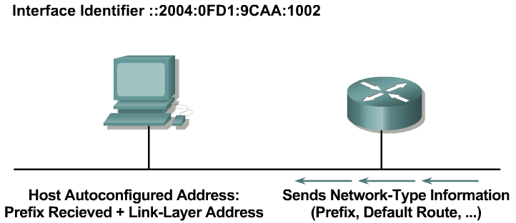
Bezstavová konfigurácia
(Stateless Autoconfiguration)
Smerovač posiela rozhraním informácie všetkým uzlom na sieti (tzv. router advertisement správy, RA)
Stanica si dokáže sama prideliť adresu tak, že pripojí svoj 64-bitový Interface ID k prefixu siete, ktorý prijala od routera v RA správe
Výsledok je 128-bitová adresa, ktorá je použiteľná a garantovane globálne unikátna
Notes:
A router on the local link can send network information, such as a 64-bit prefix of the local link network and the default route. It sends this to all the nodes on the local link. A host can autoconfigure itself by appending its IPv6 interface identifier (64-bit format) to the local link prefix (64 bits). This process results in a full 128-bit address that is usable and guaranteed to be globally unique.
A process called duplicate address translation is enabled to detect and avoid duplicate addresses.
Autoconfiguration enables the plug-and-play feature, which allows devices to connect themselves to the network without any configuration and without any servers (like DHCP servers). This key feature enables deployment of new devices on the Internet, such as cellular phones, wireless devices, home appliances, and home networks.
Note: Stateless DHCP is a new concept (February 2004) that strikes a middle ground between stateless autoconfiguration and the thick-client approach of stateful DHCP. Stateless DHCP for IPv6 is also called “DHCP-lite.” See RFC 3736, Stateless Dynamic Host Configuration Protocol (DHCP) Service for IPv6.

Slide 31
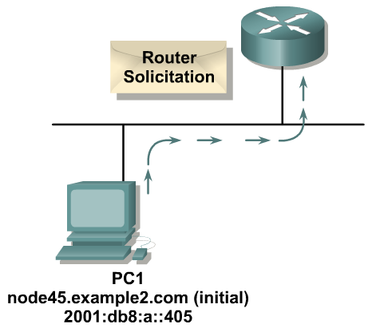
Postup bezstavovej konfigurácie adresy
Fáza 1: PC odošle správu „router solicitation“ a vyžiada si sieťový prefix pre bezstavovú konfiguráciu
Notes:
The PC first configures its link-local address and then sends a router solicitation to request a prefix for stateless autoconfiguration.

Slide 32
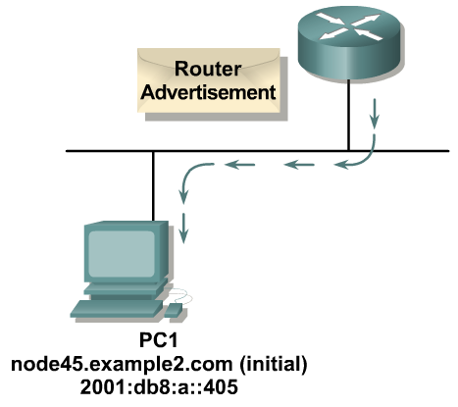
Postup bezstavovej konfigurácie adresy
Fáza 2: Router odpovedá správou Router Advertisement, v ktorej uvedie okrem iných údajov aj prefix lokálnej siete
Notes:
The router replies with a router advertisement, including prefix information.

Slide 33
Autokonfigurované adresy
Stavy automaticky nastavenej adresy:
  Tentative (neoverená, pokusná)
    V procese preverovania unikátnosti (Duplicate Address Detection)
    Unicast komunikácia je zakázaná
    Multicast komunikácia – len správy Neighbor Advertisement
  Valid (platná)
    Unikátnosť adresy bola potrvrdená
    Adresu je možné používať
    Stav Valid obsahuje v sebe ďalšie 2 stavy: Preferred a Deprecated
      Preferred (normálny stav) – adresa je platná
      Deprecated (neschválená) – adresa je platná, ale je zbavená schopnosti nadväzovať nové spojenia, existujúca komunikácia môže prebiehať ďalej
  Invalid (neplatná)
    Do tohto stavu sa adresa dostane adresa po uplynutí časovača Valid Lifetime
    Adresa v tomto stave nie je použiteľná

Slide 34
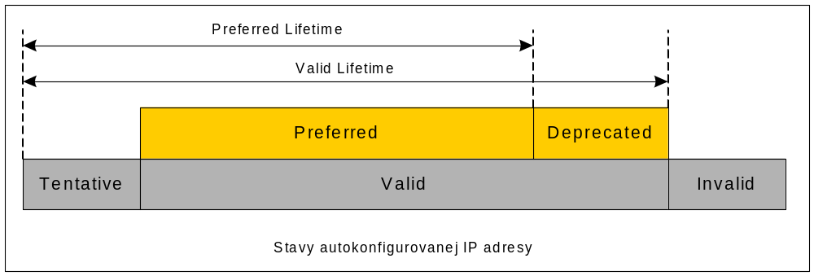
Stavy automatickej IP adresy
Autokonfigurovaná adresa prechádza týmito stavmi cyklicky, trvanie stavov získa zo správy Router Advertisement
Autokonfigurované adresy obvykle patria na koncové stanice, smerovače ich spravidla nevyužívajú

Slide 35

Konfigurácia
IPv6 na smerovači

Slide 36
Konfigurácia IPv6 na smerovači
IPv6 podporu na smerovači je potrebné najprv aktivovať príkazom
IPv6 sa konfiguruje veľmi podobne ako IPv4
  Vo všetkých známych príkazoch sa píše „ipv6“ namiesto „ip“
  Platí pre konfiguráciu adries či statických ciest
Router(config)#
ipv6 unicast-routing
ipv6 cef
Router(config)# ipv6 route 2000::/3 2001:4118:300:122::1
Router(config)# interface fa0/0
Router(config-if)# ipv6 address 2001:4118:300:123::1/64

Slide 37
Spôsoby konfigurácie IPv6 adresy
Statické pridelenie:
Automatické vytvorenie InterfaceID pomocou EUI-64:
Bezstavová autokonfigurácia (RS/RA):
Router(config-if)#
ipv6 address 2001:4118:300:123::1/64
Router(config-if)#
ipv6 address 2001:4118:300:123::/64 eui-64
Router(config-if)#
ipv6 address autoconfig

Slide 38
Spôsoby konfigurácie IPv6 adresy
Aktivácia IPv6 na rozhraní bez explicitnej adresy:
Tento príkaz aktivuje podporu IPv6 na rozhraní
  Rozhranie dostane link-local adresu, no nebude mať nijakú ďalšiu adresu
  Môže byť vhodné pre rýdzo tranzitné linky (podobne ako
  IP Unnumbered), pretože smerovacie protokoly využívajú výlučne link-local adresy ako next-hop adresy
Router(config-if)#
ipv6 enable

Slide 39
Smerovacie protokoly pre IPv6

Slide 40
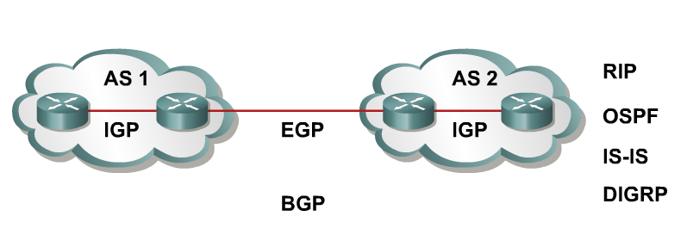
Smerovacie protokoly s podporou IPv6
Možnosti pre smerovanie v IPv6
  Statické smerovanie
  RIPng (RFC 2080)
  OSPFv3 (RFC 2740)
  IS-IS pre IPv6
  MP-BGP4 (RFC 2545/2858)
  EIGRP pre IPv6
Všetky IGP protokoly sa aktivujú na rozhraniach, nie príkazmi network
Okrem IS-IS majú všetky protokoly svoj konfiguračný odstavec s názvom ipv6 router PROTOKOL [parametre]
Notes:
Like IP version 4 (IPv4) classless interdomain routing (CIDR), IPv6 uses the same “longest-prefix match” routing. Recent protocol versions handle longer IPv6 addresses and different header structures. Currently the updated routing protocols shown in the figure are available.
Static routing with IPv6 is used and configured in the same way as with IPv4. There is an IPv6 specific requirement per RFC 2461: a router must be able to determine the link-local address of each of its neighboring routers in order to ensure that the target address of a redirect message identifies the neighbor router by its link-local address. This basically states that it is not recommended to use a global unicast address as a next-hop address with routing.
The IOS global command for IPv6 is ipv6 unicast-routing.

Slide 41
RIPng
Rovnaké vlastnosti ako v IPv4:
  Distance-vector princíp, maximálne 15 hopov, split-horizon
  a poison reverse
  Založený na RIPv2
Aktualizované vlastnosti pre IPv6:
  Prenos prefixov a next-hop adries vo formáte IPv6
  Aktualizácie posiela pomocou UDP, port 521, na multicastovú adresu FF02::9, tzv. all-rip-routers skupinu
Zatiaľ nepodporuje príkaz neighbor ani pasívne rozhrania
Split-horizon sa dá vypnúť len globálne pre celý RIPng proces
Router(config-if)#
ipv6 rip MojRIP enable
Notes:
RIPng (RFC 2080) is referred to as the Routing Information Protocol next generation (RIPng). RIPng is a distance-vector routing protocol with a limit of 15 hops, which uses split-horizon and poison reverse to prevent routing loops.
IPv6 update features include:
Based on IPv4 Routing Information Protocol version 2 (RIPv2) and similar to RIPv2
Uses IPv6 for transport
IPv6 prefix, next-hop IPv6 address
Uses the multicast group FF02::9, the all-RIP-routers multicast group, as the destination address for RIP updates
Updates are sent on User Datagram Protocol (UDP) port 521

Slide 42
Integrované IS-IS
Činnosť je zhodná s prácou IS-IS pre IPv4
Rozšírenia pre IPv6 (RFC 5308):
  2 nové triplety type-length-value (TLV):
    IPv6 reachability (128 bitový prefix)
    IPv6 interface address (128 bitov)
  Nový indentifikátor sieťového protokolu
Router(config-if)#
ipv6 router isis ! Konfigurácia “router isis” sa nemení
Notes:
IS-IS is the same as IPv4 with some extensions added:
Two new Types, Lengths, Values (TLVs)
IPv6 reachability
IPv6 interface address
New protocol ID

Slide 43
EIGRP pre IPv6
EIGRP pre IPv6 je dostupné v IOS 12.4T
Pre svoj beh vyžaduje 4-bajtové RouterID
  Ak nie je možné RouterID zistiť, je ho nutné nakonfigurovať ručne
Smerovací protokol je štandardne „vypnutý“, treba ho preto následne „zapnúť“
Router(config)# interface fa0/0
Router(config-if)# ipv6 eigrp 64512
Router(config-if)# exit
Router(config)# ipv6 router eigrp 64512
Router(config-rtr)# router-id 158.193.138.255
Router(config-rtr)# no shutdown

Slide 44
OSPF Version 3 (OSPFv3) (RFC 2740)
Podobný svojmu IPv4 proťajšku:
  Rovnaký mechanizmus, avšak pomerne podstatné úpravy „vnútorností“
Pre svoj beh vyžaduje 4-bajtové RouterID
  Ak nie je možné RouterID zistiť, je ho nutné nakonfigurovať ručne
Aktualizované vlastnosti pre IPv6 budú popísané neskôr
Router(config)# interface fa0/0
Router(config-if)# ipv6 ospf 1 area 0
Router(config-if)# exit
Router(config)# ipv6 router ospf 1
Router(config-rtr)# router-id 158.193.138.255
Notes:
The protocol implementation for IPv6 includes:
Based on OSPF version 2 (OSPFv2), with enhancements
Distributes IPv6 prefixes
Runs directly over IPv6
OSPFv3 and OSPFv2 are independent processes, run as “Ships in the night”
This implementation adds these IPv6-specific attributes:
128-bit addresses
Link-local address
Multiple addresses and instances per interface
Authentication (now uses IPsec)
OSPFv3 runs over a link rather than a subnet

Slide 45
Multiprotocol Border Gateway Protocol (MP-BGP) (RFC 2858)
Multiprotokolové rozšírenia pre BGPv4:
  Podpora rôznych sieťových protokolov
  Identifikátory rodín sieťových protokolov
Špecifické rozšírenia pre IPv6:
  NEXT_HOP obsahuje globálnu IPv6 adresu a prípadne aj link-local adresu (len ak sused je priamo pripojený)
  NEXT_HOP a NLRI (Network Layer Reachability Information) sú vyjadrené ako IPv6 adresy v atribútoch MP-BGP
Notes:
To make Border Gateway Protocol version 4 (BGP4) available for other network layer protocols, RFC 2858 (which obsoletes RFC 2283) defines multiprotocol extensions for BGP4.
MP-BGP is used to enable BGP4 to carry information of other protocols, for example, Multiprotocol Label Switching (MPLS) and IPv6.

Slide 46
OSPFv3

Slide 47
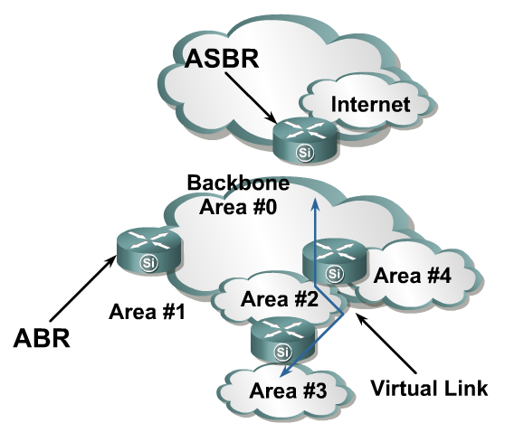
OSPFv3 – Pripomenutie vlastností
Autonómny systém je rozdelený na oblasti
Topológia jednej oblasti je skrytá pred ostatnými
  Preposielania LSA je limitované hranicami oblastí
  Dijkstrov algoritmus sa spúšťa nezávisle v každej oblasti a pre každú oblasť
Chrbticová oblasť musí
byť súvislá
Všetky oblasti musia
byť pripojené k chrbtici
  Inak sa musí použiť virtual link
Notes:
OSPFv3, which is described in RFC 2740, supports IPv6.
OSPF is a routing protocol for IP. It is a link-state protocol. A link-state protocol makes its routing decisions based on the states of the links that connect source and destination machines.
The state of a link is a description of that interface and its relationship to its neighboring networking devices. The interface information includes the IPv6 prefix of the interface, the network mask, the type of network it is connected to, the routers connected to that network, and so on.
This information is propagated in various types of link-state advertisements (LSAs). A router’s collection of LSA data is stored in a link-state database (LSDB). The contents of the database, when subjected to Dijkstra’s algorithm, result in the creation of the OSPF routing table.
The difference between the database and the routing table is that the database contains a complete collection of raw data; the routing table contains a list of shortest paths to known destinations via specific router interface ports.

Slide 48
OSPFv3—Podobnosti s OSPFv2
OSPFv3 je verzia OSPF pre IPv6 (RFC 2740):
  Vychádza z OSPFv2 + rozšírenia
  Distribuuje IPv6 prefixy
  Beží priamo nad IPv6
OSPFv3 & v2 je možné v sieti prevádzkovať súčasne, každá si spravuje vlastnú databázu
OSPFv3 používa rovnaké základné typy paketov:
  Hello
  Database description block (DDB)
  Link state request (LSR)
  Link state update (LSU)
  Link state acknowledgement (LSAck)
Notes:
Although most of the algorithms of OSPFv2 are the same in OSPFv3, some changes have been made in OSPFv3, particularly to handle the increased address size in IPv6 and the fact that OSPF runs directly over IP.
Other similarities to OSPFv2 include:
OSPFv3 uses the same basic packet types as OSPFv2, such as hello, database description (DBD) (also called database description packets [DDP]), link-state request (LSR), link-state update (LSU), and LSA.
Mechanisms for neighbor discovery and adjacency formation are identical.
Operations of OSPFv3 over the RFC-compliant nonbroadcast multiaccess (NBMA) and point-to-multipoint topology modes are supported. OSPFv3 also supports the other modes from Cisco such as point-to-point and broadcast including the interface.
LSA flooding and aging are the same for both OSPFv2 and OSPFv3.

Slide 49
OSPFv3—Podobnosti s OSPFv2
Mechanizmus zisťovania susedov a tvorby neighborhood/adjacency sú identické
Podpora pre RFC-definované NBMA a point-to-multipoint režimy je identická, rovnako ako Cisco špecifická podpora pre point-to-point a broadcast
Princíp pre LSA flooding and aging je zhodný
Notes:
Because OSPFv2 is heavily dependent on the IPv4 address for its operation, changes were necessary in the OSPFv3 protocol to support IPv6, as outlined in RFC 2740 OSPF for IPv6. Some of the notable changes include platform-independent implementation, protocol processing per-link rather than per-node processing, explicit support for multiple instances per link, and changes in authentication and packet format.
IPv6 OSPF is now an Internet Engineering Task Force (IETF) proposed standard. Like RIPng, IPv6 OSPFv3 uses IPv6 for transport and uses link-local addresses as source address.
All of OSPF for IPv4 optional capabilities, including on-demand circuit support, not-so-stubby areas (NSSAs), and the extensions to Multicast OSPF (MOSPF), are also supported in OSPF for IPv6.

Slide 50
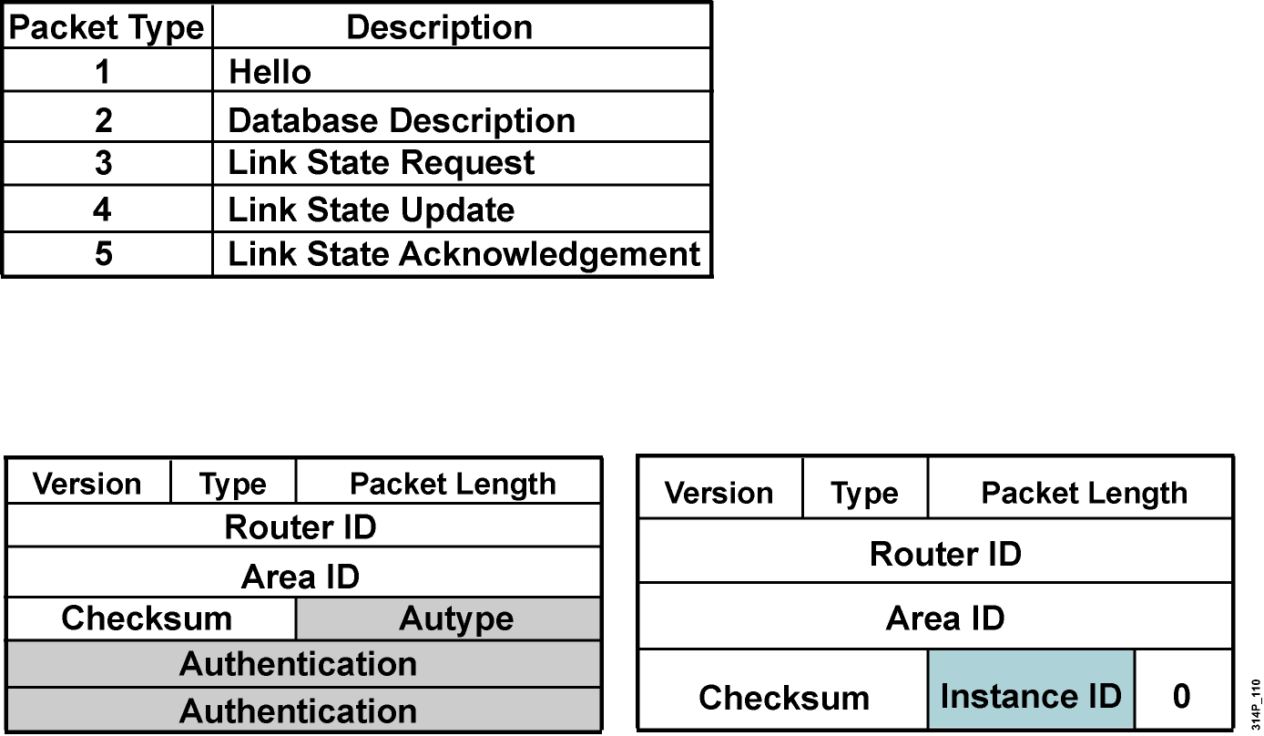
Rozdiely medzi OSPFv2 a OSPFv3
OSPFv3 má rovnaké typy paketov, niektoré však zmenili formát
Všetky OSPFv3 pakety majú 16B hlavičku namiesto 24B hlavičky v OSPFv2
Notes:
OSPFv2 was primarily concerned with the subnet on which it was operating, whereas OSPFv3 is concerned with the links to which the router is connected.
OSPFv2 did not define or allow for multiple instances per link, although similar functionality could be made by other mechanisms such as subinterfaces. OSPFv3 has explicit support for instances through the instance field.
Authentication is no longer part of OSPF; it is now the job of IPv6 to make sure the right level of authentication is in use.

Slide 51
Rozdiely medzi OSPFv2 a OSPFv3
OSPFv3 pracuje nad linkou, nie nad subnetom
V IPv6 sú rozhrania pripojené k linkám, nie k subnetom
Nad jednou linkou môže byť mnoho IPv6 „subnetov“ – prefixov
Pojmy „network“ a „subnet“ sa nahradzujú pojmom “link”
Dva OSPFv3 routery môžu komunikovať, aj ak na linke nemajú spoločný subnet – prefix
Notes:
OSPFv3 runs over a link: The network statement in the router subcommand mode of OSPFv2 is replaced by an OSPFv3 command to apply to the interface configuration. It is possible to have multiple instances per link.
Link-local address: OSPFv3 uses IPv6 link-local addresses to identify the OSPFv3 adjacency neighbors

Slide 52
Rozdiely medzi OSPFv2 a OSPFv3
Nad jednou linkou môže bežať viacero OSPFv3 inštancií
Je možné, aby jedna linka patrila do viacerých nezávislých oblastí, napríklad pri spojení dvoch autonómnych systémov
V paketoch OSPFv3 je definované nové pole s názvom Instance ID, ktoré identifikuje inštanciu OSPFv3, ktorá daný paket vygenerovala
Aby dva OSPFv3 routery komunikovali, musia sa zhodnúť na čísle inštancie. By default, číslo inštancie je 0 a pre každú ďalšiu inštanciu sa inkrementuje.
Notes:
IPv6 uses the term “link” to indicate “a communication facility or medium over which nodes can communicate at the link layer.”
Interfaces connect to links. Multiple IP subnets can be assigned to a single link, and two nodes can talk directly over a single link, even if they do not share a common IP subnet (IPv6 prefix). For this reason, OSPF for IPv6 runs per-link instead of the IPv4 behavior of per-IP-subnet. The terms network and subnet used in the IPv4 OSPF specification should generally be replaced by link. Likewise, an OSPF interface now connects to a link instead of an IP subnet, etc.
This change affects the receiving of OSPF protocol packets, and the contents of hello packets and network LSAs.

Slide 53
Rozdiely medzi OSPFv2 a OSPFv3
Použité multicastové adresy
  FF02::5 – Všetky OSPFv3 routery na segmente (link-local scope)
  FF02::6 – Všetky DR/BDR routery na segmente (link-local scope)
Zmena v spôsobe používania adries
  IPv6 adresy sa nenachádzajú v hlavičkách IPv6 paketov
  Router LSA (LSA1) a network LSA (LSA2) neobsahujú IPv6 adresy
  Router ID, area ID a link-state ID zostávajú 32-bitové
  DR a BDR sú identifikované podľa ich Router ID, nie podľa ich IPv6 adresy
Bezpečnosť
  OSPFv3 využíva IPSec hlavičky AH a ESP pre autentifikáciu
  Samotné OSPFv3 neobsahuje nijaký mechanizmus pre autentifikáciu
Notes:
Differences from OSPFv2 include the following:
Multicast addresses:
FF02::5 – Represents all shortest path first (SPF) routers on the link-local scope, equivalent to 224.0.0.5 in OSPFv2.
FF02::6 – Represents all designated routers (DRs) on the link-local scope, equivalent to 224.0.0.6 in OSPFv2.
Removal of address semantics:
IPv6 addresses are no longer present in the OSPF packet header (part of payload information).
Router LSAs and network LSAs do not carry IPv6 addresses.
Router ID, area ID and link-state ID remains at 32 bits.
DR and backup designated router (BDR) are now identified by their router ID and no longer by their IP address.
Security:
OSPFv3 uses IPv6 Authentication Header (AH) and Encapsulating Security Payload (ESP) extension headers instead of the variety of mechanisms defined in OSPFv2.

Slide 54
Prehľad LSA
 | LSA Function Code | LSA Type
Router-LSA | 1 | 0x2001
Network-LSA | 2 | 0x2002
Inter-Area-Prefix-LSA | 3 | 0x2003
Inter-Area-Router-LSA | 4 | 0x2004
AS-External-LSA | 5 | 0x4005
Group-Membership-LSA | 6 | 0x2006
Type-7-LSA | 7 | 0x2007
Link-LSA | 8 | 0x2008
Intra-Area-Prefix-LSA | 9 | 0x2009
Premenované
Nové
Notes:
OSPFv3 LSA features include:.
The LSA is composed of a router ID, area ID, and link-state ID. They are each 32 bits and are not derived from an IPv4 address.
Router LSAs and network LSAs contain only 32-bit IDs. They do not contain addresses.
LSAs have flooding scopes that define a diameter that they should be flooded to, as follows:
Link-local (flood all routers on-link)
Area (flood all routers within an OSPF area)
Autonomous system (AS) (flood all routers within the entire OSPF AS)
OSPFv3 supports the forwarding of unknown LSAs based on the flooding scope. This can be useful in an NSSA.
OSPFv3 now takes advantage of IPv6 multicasting, using FF02::5 for all OSPF routers and FF02::6 for the OSPF designated router and the OSPF BDR.
The two renamed LSAs are as follows:
Interarea prefix LSAs for area border routers (ABRs) (type 3): Type 3 LSAs advertise internal networks to routers in other areas (interarea routes). Type 3 LSAs may represent a single network or a set of networks summarized into one advertisement. Only ABRs generate summary LSAs. In OSPF for IPv6, addresses for these LSAs are expressed as prefix, prefix length instead of address, mask. The default route is expressed as a prefix with length 0.
Interarea router LSAs for Autonomous System Boundary Routers (ASBRs) (type 4): Type 4 LSAs advertise the location of an ASBR. Routers that are trying to reach an external network use these advertisements to determine the best path to the next hop. ASBRs generate type 4 LSAs.
The two new LSAs in IPv6 are as follows:
Link LSAs (type 8): Type 8 LSAs have link-local flooding scope and are never flooded beyond the link with which they are associated. Link LSAs provide the link-local address of the router to all other routers attached to the link, inform other routers attached to the link of a list of IPv6 prefixes to associate with the link, and allow the router to assert a collection of options bits to associate with the network LSA that will be originated for the link.
Intra-area prefix LSAs (type 9): A router can originate multiple intra-area prefix LSAs for each router or transit network, each with a unique link-state ID. The link-state ID for each intra-area prefix LSA describes its association to either the router LSA or the network LSA. The link-state ID also contains prefixes for stub and transit networks.

Slide 55
Konfigurácia OSPFv3

Slide 56
Konfigurácia OSPFv3
Využíva sa spôsob konfigurácie priamo na rozhraní podobne ako
v OSPFv2 resp. IS-IS
  Namiesto slova „ip“ sa používa „ipv6”
OSPFv3 sa zásadne konfiguruje na rozhraniach
  Príkaz network v OSPFv3 neexistuje
Konfiguračná sekcia pre OSPFv3 (arey, autentifikácia, Router ID...)
  Samostatný kontext: ipv6 router ospf process-id
  Väčšina známych príkazov z OSPFv2 sa používa rovnako, resp. primerane vzhľadom na zmenu formátu adresy (napr. sumarizácia príkazmi area range, summary-prefix, nastavenie typov arey, redistribúcia, atď...)
Notes:
OSPFv3 has the following Cisco IOS attributes:
Network area command: The way to identify IPv6 networks that are part of the OSPFv3 network is different than with OSPFv2 configuration. The network area command in OSPFv2 is replaced by a configuration in which interfaces are directly configured to specify that IPv6 networks are part of the OSPFv3 network.
Native IPv6 router mode: The configuration of OSPFv3 is not a subcommand mode of the router ospf command (as it is in OSPFv2 configuration).

Slide 57
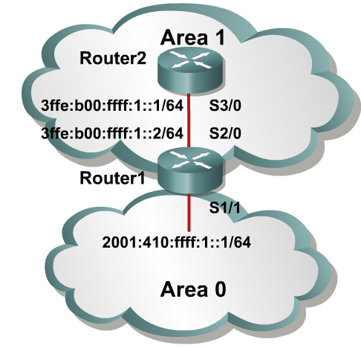
OSPFv3 Configuration Example
Router1(config)#
ipv6 unicast-routing
interface S1/1
ipv6 address 2001:410:FFFF:1::1/64
ipv6 ospf 100 area 0
interface S2/0
ipv6 address 3FFE:B00:FFFF:1::2/64
ipv6 ospf 100 area 1
ipv6 router ospf 100
router-id 10.1.1.3
Router2(config)#
ipv6 unicast-routing
interface S3/0
ipv6 address 3FFE:B00:FFFF:1::1/64
ipv6 ospf 100 area 1
ipv6 router ospf 100
router-id 10.1.1.4
Notes:
The example shows an OSPF network of two routers, with an area 0 and area 1.
The interface-specific command ipv6 ospf 100 area 0 will create the “ipv6 router ospf 100” process dynamically, as will the ipv6 ospf 100 area 1 command.

Slide 58
Migrácia medzi IPv4 a IPv6

Slide 59
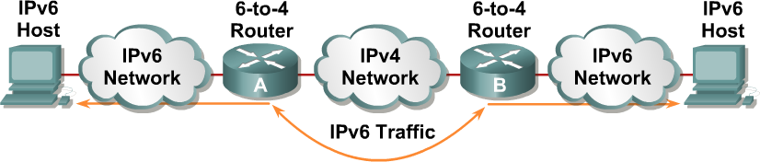
Migrácia medzi IPv4 a IPv6
Pre migráciu z IPv4 na IPv6 je definovaných niekoľko rôznych mechanizmov, a nie je nevyhnutné urobiť skokový prechod
Migračné mechanizmy
  Dual-stack
  Statické tunely, 6over4 tunely (zriedka používané, RFC 2529), 6to4 tunely (RFC 3056)
  ISATAP tunely (RFC 4214)
  Teredo tunely (RFC 4380)
  NAT-PT (Protocol Translation)
Notes:
The transition from IPv4 does not require upgrades on all nodes at the same time. Many transition mechanisms enable smooth integration of IPv4 and IPv6. Other mechanisms that allow IPv4 nodes to communicate with IPv6 nodes are available. All of these mechanisms are applied to different situations.
The two most common techniques to transition from IPv4 to IPv6 are as follows:
Dual stack
IPv6-to-IPv4 (6-to-4) tunnels
For communication between IPv4 and IPv6 networks, there can be IPv4 addresses that are encapsulated in an IPv6 address.
The figure shows an example of a transition and integration mechanism. The 6-to-4 routers automatically encapsulate the IPv6 traffic inside IPv4 packets.

Slide 60
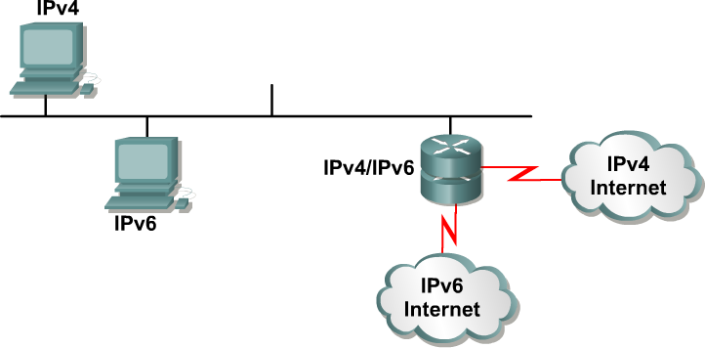
Dual Stack
Dual stack je integračná metóda, kde každá stanica aj router implementuje aj IPv4, aj IPv6
Protokoly sú na sebe úplne nezávislé
Notes:
Dual stack is an integration method where a node has implementation and connectivity to both an IPv4 and IPv6 network, and thus the node has two stacks. This configuration can be accomplished on the same interface or on multiple interfaces.
A dual-stack node chooses which stack to use based on destination address. A dual-stack node should prefer IPv6 when available. The dual-stack approach to IPv6 integration, in which nodes have both IPv4 and IPv6 stacks, will be one of the most commonly used methods. Old IPv4-only applications continue to work as before. New and modified applications take advantage of both IP layers.
A new application program interface (API) is defined to support both IPv4 and IPv6 addresses and Domain Name System (DNS) requests. This new API replaces the “gethostbyname” and “gethostbyaddr” calls. A converted application will be able to make use of both IPv4 and IPv6. An application can be converted to the new API while still using only IPv4.
Past experience in porting IPv4 applications to IPv6 says that, for most applications, it is a minimal change in some localized places inside the source code. This technique is well-known and has been applied in the past for other protocol transitions. It enables gradual application upgrades one-by-one to IPv6.

Slide 61
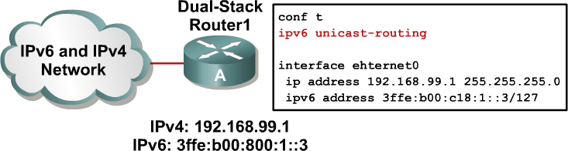
Dual stack spôsob konfigurácie
Stačí nakonfigurovať na rozhraní IPv4 aj IPv6 adresu
Notes:
Cisco IOS software is IPv6-ready. As soon as IPv4 and IPv6 basic configurations are complete on the interface, the interface is dual-stacked, and it forwards IPv4 and IPv6 traffic.
Using IPv6 on a Cisco IOS router requires that you use the global configuration command ipv6 unicast-routing. This command enables the forwarding of IPv6 datagrams. All interfaces that forward IPv6 traffic must have an IPv6 address. The interface command is as follows:
ipv6 address IPv6-address [/prefix length]
This command specifies an IPv6 network assigned to the interface and enables IPv6 processing on the interface.

Slide 62
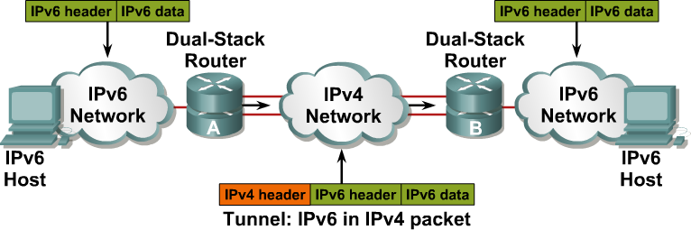
Tunelovanie IPv6 v IPv4
Tunelovanie je integračná metóda, kde sa IPv6 paket zapúzdri do paketu iného protokolu, napr. IPv4 (číslo protokolu 41)
  Overhead tohto tunela je 20B (hlavička IPv4 bez voliteľných častí)
  Tento spôsob vyžaduje dual-stacked routery
Notes:
Tunneling is an integration method where an IPv6 packet is encapsulated within another protocol, such as IPv4. This method of encapsulation is IPv4 protocol 41:
This includes a 20-byte IPv4 header with no options and an IPv6 header and payload.
This is considered dual stacking.
Tunnels are often used in networking to overlay noncompatible functionality over an existing network. When tunneling IPv6 traffic over an IPv4 network, one edge router encapsulates the IPv6 packet inside an IPv4 packet and then the other router decapsulates it, and vice versa. This enables the connection of IPv6 islands without the need to also convert an intermediary network to IPv6. Tunneling presents these two issues:
The MTU is effectively decreased by 20 octets (if the IPv4 header does not contain any optional field).
A tunneled network is often difficult to troubleshoot. Tunneling is an intermediate integration/transition technique that should not be considered a final solution. Native IPv6 architecture should be the ultimate goal.

Slide 63
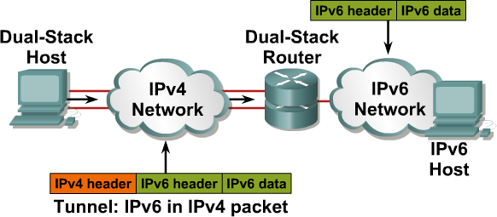
Tunelovanie IPv6 v IPv4
Zapúzdrenie môže realizovať nielen router, ale aj stanica, ak jej operačný systém ovláda príslušný spôsob tunelovania
Notes:
Encapsulation can be done by edge routers between hosts or between a host and a router. This example shows an isolated dual-stack host using an encapsulated tunnel to connect to the edge router of the IPv6 network.
Tunneling will not work if an intermediary node between the two end points of the tunnel, such as a firewall, filters out IPv4 protocol 41, which is the IPv6 in IPv4 encapsulation.

Slide 64
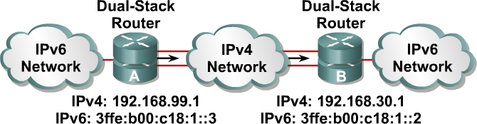
Konfigurácia statických tunelov
Konfigurácia statických tunelov vyžaduje:
  Dual-stack endpointy
  IPv4 a IPv6 adresy konfigurované na oboch koncoch tunela
Notes:
In a manually configured tunnel, you configure both the IPv4 and IPv6 addresses statically. Perform this configuration on the routers at each end of the tunnel.
These end routers must be dual-stacked, and the configuration cannot change dynamically as network and routing needs change. Routing must be set up properly to forward a packet between the two IPv6 networks.
Tunnel end points can be unnumbered, but unnumbered end points make troubleshooting difficult. The IPv4 practice of saving addresses for tunnel end points is no longer an issue.

Slide 65
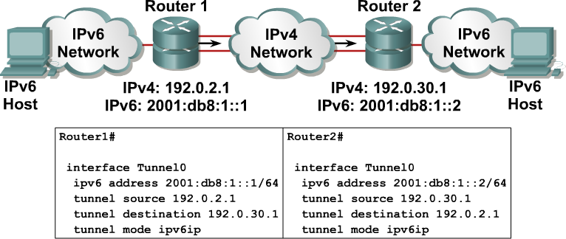
Príklad konfigurácie: statické tunely
Notes:
The example shows the configuration of two Cisco routers connected with IPv6 through IPv4 encapsulation.
The command interface Tunnel0 is used, with the tunnel source and destination specified with the underlying network addresses, which are IPv4 addresses. A static IPv6 address is configured on the tunnel0 interface.
The command that enables the IPv6-over-IPv4 tunneling is tunnel mode ipv6ip.

Slide 66
6to4 tunely (RFC 3056)
6to4 tunely sú (na rozdiel od trvalých statických tunelov) tunely, ktoré môžu mať mnoho koncových bodov
IPv6 prefixy jednotlivých IPv6 ostrovov oddelených IPv4 internetom sú navrhnuté tak, aby v sebe obsahovali priamo IPv4 adresu tunelujúceho routera, ktorý je na okraji tohto ostrova
  IPv6 adresy pri použití 6to4 tunelov využívajú prefix 2002::/16
  Ďalších 32 bitov vyjadruje IPv4 adresu routera, ktorý je na vstupe/výstupe nášho IPv6 ostrova a ktorý realizuje tunelovanie
  Výsledný 48-bitový prefix je prefix spoločný pre celý IPv6 ostrov. Zostáva tak k dispozícii 16 bitov pre Subnet ID a 64 bitov pre Interface ID, rovnako ako v bežných Global Unicast adresách
Notes:
1. A tunnel is a logical interface that acts like a logical connection between two endpoints.
It is similar to a loopback interface in that more than one interface is involved.
2. The tunnel mode ipv6ip 6to4 command constructs an automatic tunnel which determines the tunnel’s destination.
3. A 6-4 tunnel uses special IPv6 addresses in the 2002::/16 address range
A 6-4 tunnel does not require a destination address because it is no a point-to-point link.
4. Tunnel source is the interface of the router usually the serial interface that traffic will originate from.
5.

Slide 67
6to4 tunely (RFC 3056)
Príklad:
  Router na vstupe do nášho IPv6 ostrovčeka má verejnú IPv4 adresu 192.0.2.36
  Hexadecimálny prepis tejto adresy je C0.0.2.24
  Všetky IPv6 zariadenia v našom ostrovčeku majú teda IPv6 prefix 2002:C000:0224/48
  Routery na susedných IPv6 lokalitách musia mať akurát vhodne nastavené smerovanie, aby pre prístup do IPv6 sietí s prefixom 2002::/16 používali 6to4 tunel
Postup konfigurácie:
  Vytvoriť rozhranie pre tunel
  Nastaviť režim tunela: tunnel mode ipv6ip 6to4
  Vytvoriť primeraný adresový plán a nastaviť IPv6 adresy na rozhraniach
  Nastaviť vhodnú IPv6 adresu na tuneli, alebo si ju vypožičať cez príkaz unnumbered
  Nastaviť IPv6 smerovanie cez tunel
Notes:
The 1 at the end of the address is a more specific subnet
The 1 at the end is the host address
/64 is the subnet

Slide 68
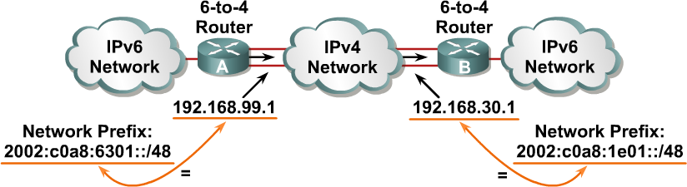
6to4 tunely (RFC 3056)
6to4:
  Na tuneloch nie je potrebné definovať endpoint (druhý koniec)
  Každý IPv6 ostrov má jednoznačný globálne platný prefix
Notes:
The 6-to-4 tunneling method automatically establishes the connection of IPv6 islands through an IPv4 network. The 6-to-4 tunneling method applies a valid IPv6 prefix to each IPv6 island, which enables the fast deployment of IPv6 in a corporate network without address retrieval from the Internet service providers (ISPs) or registries.
The 6-to-4 tunneling method requires a special code on the edge routers, but the IPv6 hosts and routers inside the 6-to-4 site do not require new features to support 6-to-4. Each 6-to-4 site receives a /48 prefix, which is the concatenation of 0x2002 and the hexadecimal IPv4 address of the edge router.
For example, if the IPv4 address of the edge router is 192.168.99.1, the prefix of its IPv6 network is 2002:c0a8:6301::/48, because c0a86301 is the hexadecimal representation of 192.168.99.1. The IPv6 network can substitute any IP address in the space after the first 16-bit section (0x2002).
When an IPv6 packet with a destination address in the range of 2002::/16 reaches the 6-to-4 edge router, the 6-to-4 edge router extracts the IPv4 address that is embedded in the 2002:: destination address (inserted between the third and sixth octets inclusively). The 6-to-4 router then encapsulates the IPv6 packet in an IPv4 packet with the destination IPv4 address that was extracted from inside the IPv6 destination address.
This IPv4 address represents the address of the other 6-to-4 edge router of the destination 6-to-4 site. The destination edge router de-encapsulates the IPv6 packet in the IPv4 packet and then forwards the native packet toward its final destination.

Slide 69

Príklad konfigurácie: 6to4 tunel
Lo0 10.1.2.1/24
172.16.23.1 /24 S0/0/1
R2
S0/0/1 172.16.23.2 /24
Lo0 10.1.3.1/24
S0/0/0 172.16.12.2 /24
R3
172.16.12.1 /24 S0/0/0
R1
Lo0 10.1.1.1/24
R1
R1(config)# interface tunnel 0
R1(config-if)# tunnel mode ipv6ip 6to4
R1(config-if)# ipv6 address 2002:AC10:0C01:1::1/64
R1(config-if)# tunnel source s0/0/0
Exit
R1(config)# ipv6 route 2002::/16 tunnel 0
Verification
R1#ping 2002:AC10:1701:1::3
R3
R3(config)# interface tunnel 0
R3(config-if)# tunnel mode ipv6ip 6to4
R3(config-if)# ipv6 address 2002:AC10:1701:1::3/64
R3(config-if)# tunnel source s0/0/1
Exit
R3(config)# ipv6 route 2002::/16 tunnel 0
Verification
R3#ping 2002:AC10:0C01:1::1
Notes:
The following example creates a tunnel between R1 and R3’s loopback interfaces.
The static route automatically routes all 2002::/16 address through the tunnel.
The ipv6 route 2002::/16 tunnel 0 command sets up a static route for the whole 2002::/16

Slide 70
Konfigurácia statického smeru cez 6to4 tunel
Lo0 10.1.2.1/24
172.16.23.1 /24 S0/0/1
R2
S0/0/1 172.16.23.2 /24
Lo0 10.1.3.1/24
S0/0/0 172.16.12.2 /24
R3
172.16.12.1 /24 S0/0/0
R1
Lo0 10.1.1.1/24
Router 1
Router1(config)# ipv6 unicast-routing
Router1(config)# ipv6 route FEC0::3:0/112 2002:AC10:1701:1::3
Router 3
Router3(config)# ipv6 unicast-routing
Router3(config)# ipv6 route FEC0::1:0/112 2002:AC10:C01:1::1
Next hop oboch smerovačov je IPv6 adresa proťajšieho konca tunela
Notes:
The previous example created a static route allowing 2002::/16 address to pass through a 6to4 tunnel
This example creates a static route between R1 and R3’s loopback interface and vice versa.
The next hop for both routers is the

Slide 71
6to4 Relay – prestup do IPv6 sveta
Systém 6to4 umožňuje spojenie s IPv6 ostrovom cez medziľahlú IPv4 sieť
Dá sa teda aj použiť na prístup do IPv6 sveta
  Stačí vhodná brána, ktorá akceptuje 6to4 tunely
  Na túto bránu budeme smerovať všetko, čo pôjde do IPv6
RFC 3068 stanovuje, že provideri podľa svojho rozhodnutia môžu takúto bránu vytvoriť
  Táto brána musí mať adresu 192.88.99.1
  Smerovače na prístup do IPv6 internetu použijú statický smer
ipv6 route 2000::/3 2002:c058:6301::

Slide 72
ISATAP tunely
ISATAP tunely (RFC 5214) sú obdobou 6to4 tunelov
  Majú primárne zabezpečovať vnútrofiremnú (intra-site) komunikáciu
  Takisto využívajú mapovanie medzi IPv4 a IPv6 adresou
  Tvar ISATAP IPv6 adries:
    Prvých 64 bitov: link-local alebo global unicast prefix
    Ďalších 32 bitov: 0000:5EFE (konštanta)
    Zvyšných 32 bitov: IPv4 adresa stanice
    Dĺžka prefixu: 64 bitov
  Novinka: Využitie pomocných mechanizmov (DHCP, DNS, manuálna konfigurácia) pre lokalizáciu smerovačov schopných zabezpečiť smerovanie medzi rôznymi IPv6 sieťami

Slide 73
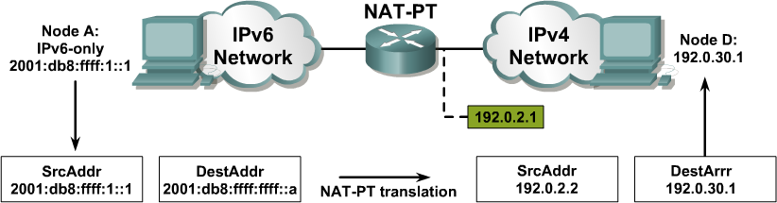
Preklad protokolov: NAT-PT
NAT-Protocol Translation (NAT-PT) je prekladový mechanizmus na rozhraní medzi IPv6 a IPv4 sieťou
Jeho úlohou je prekladať IPv6 pakety na IPv4 a naopak
Tento prístup je vhodný pre umožnenie spolupráce medzi uzlami,
z ktorých jeden je IPv4-only alebo IPv6-only
Notes:
For legacy equipment that will not be upgraded to IPv6 and for some deployment scenarios, techniques that can connect IPv4-only nodes on IPv6-only nodes are available. Translation is basically an extension of NAT techniques.
The example on this page shows the translation of an IPv6 datagram sent from node A to node D. From the perspective of node A, it is establishing a communication to another IPv6 node. One advantage of NAT-PT is that no modifications are required on IPv6 node A; all it needs to know is the IPv6 address mapping to the IPv4 address of node D. This mapping can be obtained dynamically from the DNS server.
IPv4 node D can also send a datagram to node A by using the IPv4 address mapped to the IPv6 address of node A. Again, from the perspective of node D, it is establishing an IPv4 communication to its correspondent. Again, node D requires no modification.

Slide 74
NAT-PT
Smerovač pomocou NAT-PT modifikuje zdrojovú i cieľovú adresu v oboch smeroch toku dát
  Z IPv4 siete do IPv6 siete
  Z IPv6 siete do IPv4 siete
Smerovač musí preto využívať dual stack a mať dve sady prekladov pre obojsmerný preklad

Slide 75
NAT-PT
Pri NAT-PT využívame 96-bitový IPv6 sieťový prefix na reprezentáciu celého IPv4 sveta
  Tento prefix môže byť ľubovoľný dosiahnuteľný prefix v IPv6 sieti
  Akákoľvek IPv4 stanica je reprezentovaná z pohľadu IPv6 sveta ako adresa v tomto prefixe
  Tento prefix musí byť ohlasovaný zo smerovača, ktorý robí NAT-PT
Keď príde IPv6 paket na cieľovú adresu v priestore tohto prefixu, smerovač ho transformuje na IPv4 paket
  Zmení obe adresy – zdroj i cieľ
  Mapovanie medzi IPv6 a IPv4 adresami je možné konfigurovať staticky alebo dynamicky

Slide 76
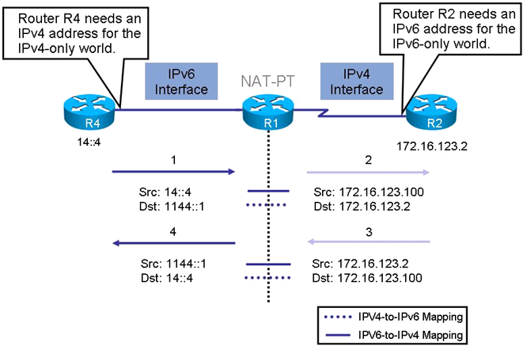
Príklad činnosti NAT-PT

Slide 77
Konfigurácia statického NAT-PT
Preklad zdrojovej IPv4 na zdrojovú IPv6 (paket idúci z IPv4 siete do IPv6 siete)
Router(config)#
ipv6 nat v4v6 source ipv4-address ipv6-address
Preklad zdrojovej IPv6 na zdrojovú IPv4 (paket idúci z IPv6 siete do IPv4 siete)
Router(config)#
ipv6 nat v6v4 source ipv6-address ipv4-address
Definovanie IPv6 prefixu reprezentujúceho IPv4 svet
Router(config)# alebo Router(config-if)#
ipv6 nat prefix ipv6-prefix/96
Zaradenie rozhraní do NAT-PT
Router(config-if)#
ipv6 nat

Slide 78
Verifying and Troubleshooting NAT-PT
Command | Description
show ipv6 nat translations | Displays active NAT-PT translations. Each translation is displayed over two lines.
show ipv6 nat statistics | Displays NAT-PT statistics.
debug ip icmp | Displays ICMPv6 events in real time.
debug ipv6 nat | Displays debug messages for NAT-PT translation events

Slide 79
Príklad pre statické NAT-PT (1)
IPv4 Only
Lo103: 103::1/64
13::3/64
R3
172.16.123.0/24
13::1/64
IPv6 RIP NAT-PT
.2
.1
R2
R1
14::1/64
S0/1/0
S0/0/0
14::4/64
R4
Lo104: 104::1/64
R1(config)# interface s0/0/0
R1(config-if)# ipv6 nat
%LINEPROTO-5-UPDOWN: Line protocol on Interface NVI0, changed state to up
R1(config-if)# interface s0/1/0
R1(config-if)# ipv6 nat
R1(config-if)# exit
R1(config)#

Slide 80
Príklad pre statické NAT-PT (2)
IPv4 Only
Lo103: 103::1/64
13::3/64
R3
172.16.123.0/24
13::1/64
IPv6 RIP NAT-PT
.2
.1
R2
R1
14::1/64
S0/1/0
S0/0/0
14::4/64
R4
Lo104: 104::1/64
R1(config)# ipv6 nat v6v4 source 14::4 172.16.123.100
R1(config)# ipv6 nat v4v6 source 172.16.123.2 1144::1
R1(config)#
R1(config)# ipv6 nat prefix 1144::/96
R1(config)#

Slide 81
Príklad pre statické NAT-PT (3)
IPv4 Only
Lo103: 103::1/64
13::3/64
R3
172.16.123.0/24
13::1/64
IPv6 RIP NAT-PT
.2
.1
R2
R1
14::1/64
S0/1/0
S0/0/0
14::4/64
R4
Lo104: 104::1/64
R1# show ipv6 route connected
<output omitted>
C 13::64 [0/0]
via FastEthernet0/0, directly connected
C 14::/64 [0/0]
via Serial0/0/0, directly connected
C 1144::/96 [0/0]
via NVI0, directly connected
R1#

Slide 82
Príklad pre statické NAT-PT (4)
IPv4 Only
Lo103: 103::1/64
13::3/64
R3
172.16.123.0/24
13::1/64
IPv6 RIP NAT-PT
.2
.1
R2
R1
14::1/64
S0/1/0
S0/0/0
14::4/64
R4
Lo104: 104::1/64
R1# config t
R1(config)# ipv6 router rip NAT-PT
R1(config-rtr)# redistribute connected metric 3
R1(config-rtr)# exit
R1#

Slide 83
Príklad pre statické NAT-PT (5)
IPv4 Only
Lo103: 103::1/64
13::3/64
R3
172.16.123.0/24
13::1/64
IPv6 RIP NAT-PT
.2
.1
R2
R1
14::1/64
S0/1/0
S0/0/0
14::4/64
R4
Lo104: 104::1/64
R4# show ipv6 route rip
<ouput omitted>
R 13::/64 [120/2]
via FE80::1, Serial 1/1.7
R 1144::/96 [120/4]
via FE80::1, Serial 1/1.7
R4#

Slide 84
Príklad pre statické NAT-PT (6)
IPv4 Only
Lo103: 103::1/64
13::3/64
R3
172.16.123.0/24
13::1/64
IPv6 RIP NAT-PT
.2
.1
R2
R1
14::1/64
S0/1/0
S0/0/0
14::4/64
R4
Lo104: 104::1/64
R4# ping 1144::1
Type escape sequence to abort.
Sending 5, 100-byte ICMP Echos to 1144::1, timeout is 2 seconds:
!!!!!
Success rate is 100 percent (5/5), round-trip min/avg/max = 68/70/73 ms
R4#

Slide 85
Príklad pre statické NAT-PT (7)
IPv4 Only
Lo103: 103::1/64
13::3/64
R3
172.16.123.0/24
13::1/64
IPv6 RIP NAT-PT
.2
.1
R2
R1
14::1/64
S0/1/0
S0/0/0
14::4/64
R4
Lo104: 104::1/64
R1# show ipv6 nat translations
Prot IPv4 source IPv6 source
IPv4 destination IPv6 destination
—- —- —-
172.16.123.2 1144::1
icmp 172.16.123.100,7364 14::4, 7364
172.16.123.2, 7364 1144::1, 7364
—- 172.16.123.100 14::4
—- —-
R1#

Slide 86
Porovnanie IPv4 a IPv6 (1)
IPv4 | IPv6
Zdrojová a cieľová adresa majú veľkosť 32 bitov | Zdrojová a cieľová adresa majú veľkosť 128 bitov
Podpora IPsec je voliteľná | Podpora IPsec je vyžadovaná štandardom
Žiadna identifikácia tokov paketov používaná smerovačmi na zabepečenie QoS nie je v hlavičke IPv4 prítomná | Identifikácia tokov paketov používaná smerovačmi na zabepečenie QoS je v hlavičke IPv6 prítomná v poli Flow Label
Fragmentácia je zabezpečovaná smerovačmi aj vysielajúcimi stanicami | Fragmentácia je zabezpečovaná výhradne vysielajúcimi stanicami. Smerovače fragmentáciu nezabezpečujú
Hlavička obsahuje kontrolnú sumu na kontrolu integrity paketu | Hlavička kontrolnú sumu na kontrolu integrity paketu neobsahuje
Hlavička obsahuje voliteľné polia (options) | Všetky voliteľné polia sú presunuté do IPv6 rozširujúcich hlavičiek, ktoré nie sú súčasťou základnej hlavičky
Na rozpoznanie adresy linkovej vrstvy (MAC adresy) mapovanej na IPv4 adresu sa používa ARP (Address Resolution Protocol) ako broadcast | ARP funkcie na seba preberá ICMPv6 a využíva multicast

Slide 87
Porovnanie IPv4 a IPv6 (2)
IPv4 | IPv6
Na správu členstva skupín lokálnych sietí sa používa protokol IGMP (Internet Group Management Protocol) | Protokol IGMP je nahradený správami Multicast Listener Discovery (MLD)
Na určenie najlepšej predvolenej brány (default gateway) sa používa obvykle DHCP | Využívajú sa ICMPv6 Router Solicitation a Router Advertisement správy. Implementácia týchto správ je povinne vyžadovaná špecifikáciou
Na adresovanie všetkých uzlov na určitej sieti sa používajú broadcast adresy | V IPv6 neexistujú broadcast adresy. Namiesto toho existuje tzv. link-local scope all-nodes multicast adresa, ktorou môžu byť adresované všetky uzly jednej podsiete naraz
Konfigurácia prebieha manuálne alebo použitím DHCP | Nepotrebuje ani manuálnu konfiguráciu, ani DHCP. Protokol obsahuje autokonfiguráciu
Musí podporovať minimálne 576 bajtový paket (s možnosťou fragmentácie). | Musí podporovať minimálne 1280 bajtový paket (bez fragmentácie).

